Slide 1
Designing an LLC Resonant Half-Bridge Power Converter

Slide 2
Table of Contents
Introduction
1. Brief Review of Resonant Converters
2. LCC and LLC Resonant Converters
LLC Resonant Half-Bridge Converter
1. Configuration
2. Operation
3. Modelling of LLC Half-Bridge Converter
4. Voltage-Gain Function
Design Considerations
1. What Does “In the Vicinity” Mean
2. Basic Design Requirements
3. Selecting Design Parameters fsw, n, Ln, and Qe
4. Peak-Gain Curves from a Bench Test
5. Resonant-Network Design Flow
Design Example
1. Block Diagram of Proposed Converter Circuit
2. Design Steps
Conclusion

Slide 3
Introduction

Slide 4
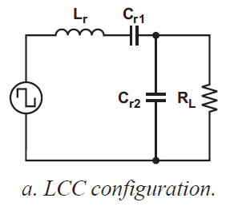
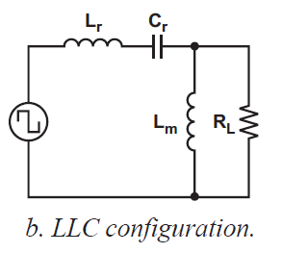
Introduction
A method for determining parameter values is explained
Brief Review of Resonant Converters
Among various converters, two basic types are – SRC and PRC
SRC – Under light-loading, impedance of load >> impedance of resonant circuit : So difficult to regulate the output voltage
PRC – Large circulating current : So difficult to apply in applications with high power density or large load variations
LCC and LLC Resonant Converters
Series-parallel resonant converter (LCC and LLC) has been proposed
LCC – Two independent capacitors (both large and expensive because of high AC currents)
LLC – Two inductors can be combined into one physical component by using T/f leakage and magnetizing inductance
– Excellent efficiency, ZVS over entire operating range

Slide 5
LLC Resonant Half-Bridge Converter

Slide 6
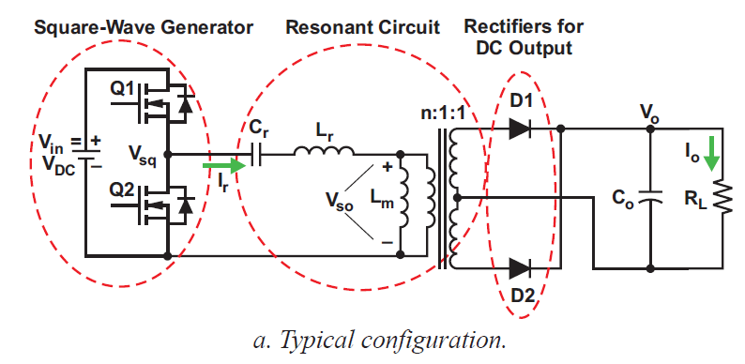
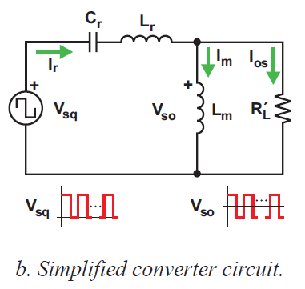
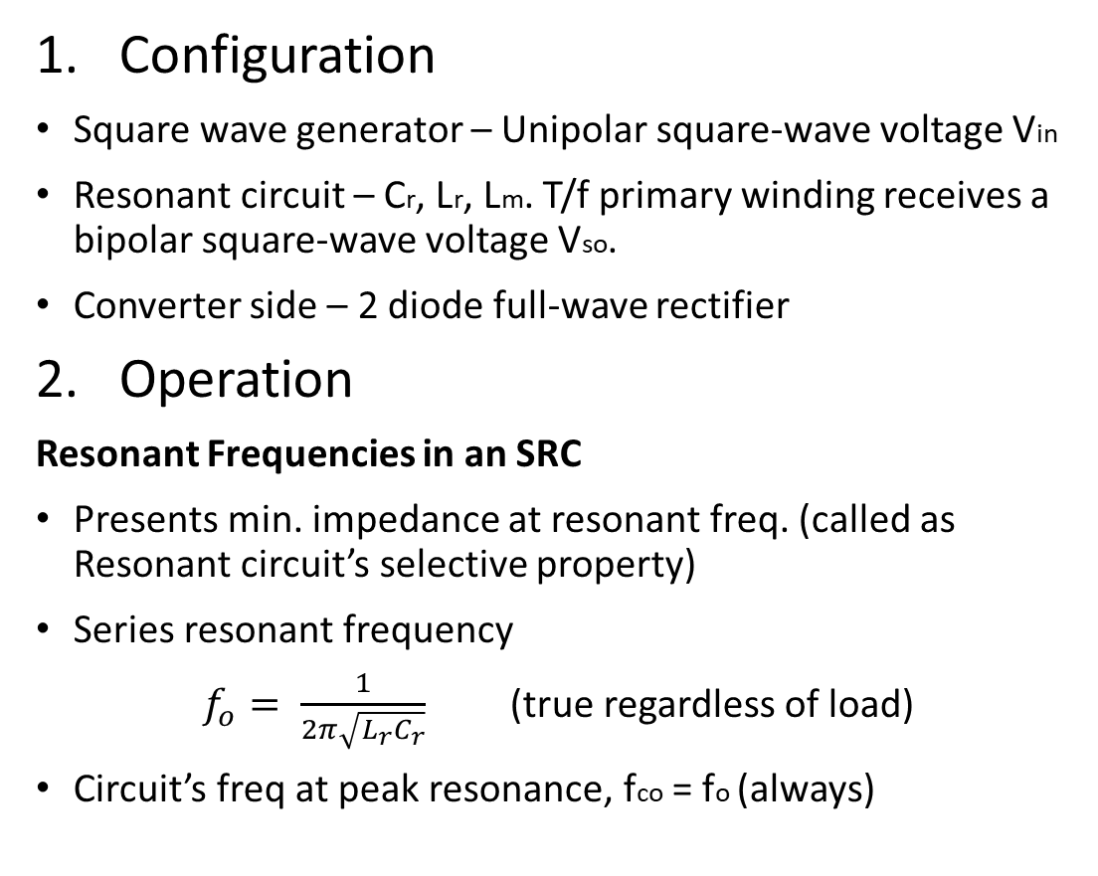
LLC Resonant Half-Bridge Converter
Configuration
Square wave generator – Unipolar square-wave voltage Vin
Resonant circuit – Cr, Lr, Lm. T/f primary winding receives a bipolar square-wave voltage Vso.
Converter side – 2 diode full-wave rectifier
Operation
Resonant Frequencies in an SRC
Presents min. impedance at resonant freq. (called as Resonant circuit’s selective property)
Series resonant frequency
$f_{o}= \frac{1}{2π\sqrt{L_{r}C_{r}}}$ (true regardless of load)
Circuit’s freq at peak resonance, fco = fo (always)

Slide 7
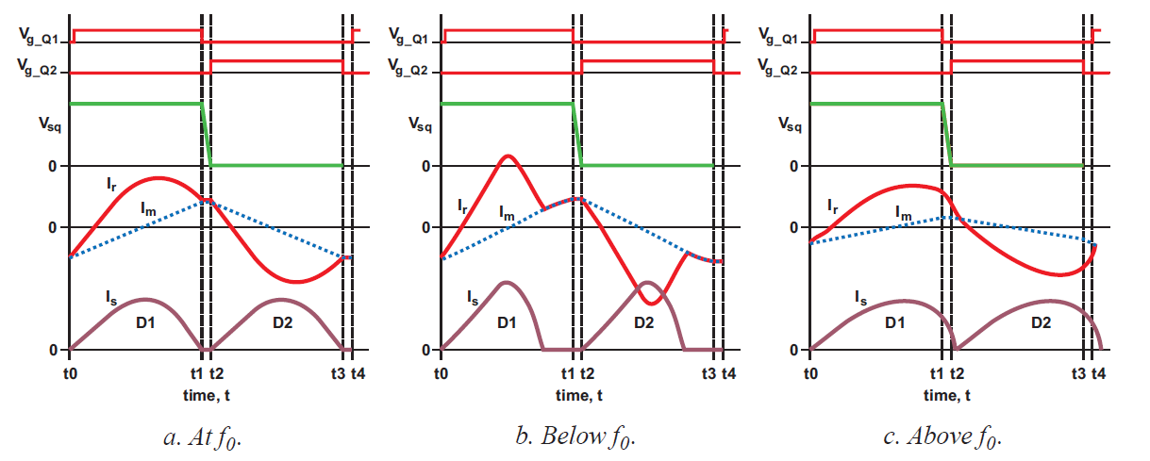

fco, fo, and fp in an LCC Circuit
LLC circuit’s freq at peak resonance (fco) = f^{n} (load) within range of fp ≤ fco ≤ fo
Pole frequency, $f_{p}= \frac{1}{2π\sqrt{(L_{r}+ L_{m})C_{r}}}$ (true only at No load)
At no load, fco = fp. As load increases, fco moves towards fo. At a load SC, fco = fo.
LLC converter is designed to operate in the vicinity of fo.
Operation At, Below, and Above fo
Notes:
ZVS possible in all three cases. When Ir falls to Im, no power transfer from primary to sec. ZVS may be lost if switching freq becomes too low than fr.

Slide 8
Operation at Resonance
When Q1 turns off, Ir falls to Im, so no power transfer to sec side.
By delaying Q2 turn on, we achieve primary ZVS and soft commutation of rectifier diodes on sec side.
Operation Below Resonance
Ir falls to Im before the end of driving pulse, so power transfer is stopped even before even though Im continues.
Still achieve primary ZVS and soft commutation of rectifier diodes.
Diodes – DCM. So, require more circulating current to deliver the same energy to load
which results in more conduction loss
If fsw << f0 : ZVS may be lost
Operation Above Resonance
Smaller circulating current in tank, conduction loss reduced because Ir is in CCM → Less RMS current is required for same energy to load.
Rectifier diode – Not soft comm^{n}
Still primary ZVS is achieved.

Slide 9
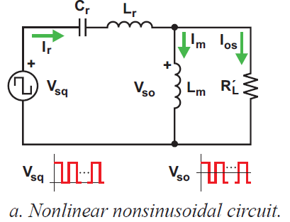
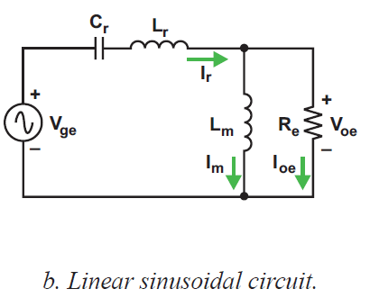
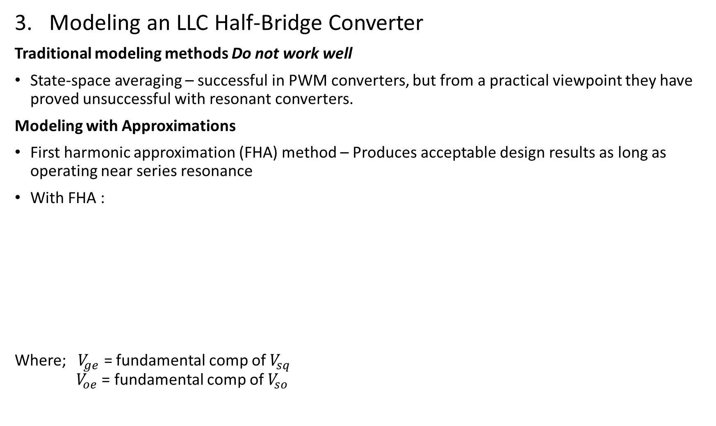
Modeling an LLC Half-Bridge Converter
Traditional modeling methods Do not work well
State-space averaging – successful in PWM converters, but from a practical viewpoint they have proved unsuccessful with resonant converters.
Modeling with Approximations
First harmonic approximation (FHA) method – Produces acceptable design results as long as operating near series resonance
With FHA :
Where; $V_{ge}$ = fundamental comp of $V_{sq}$
$V_{oe}$ = fundamental comp of $V_{so}$
Converted to

Slide 10
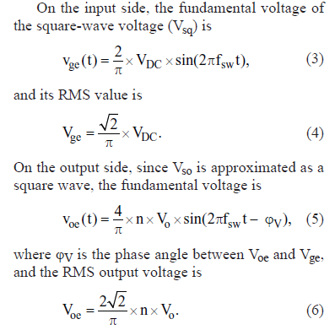
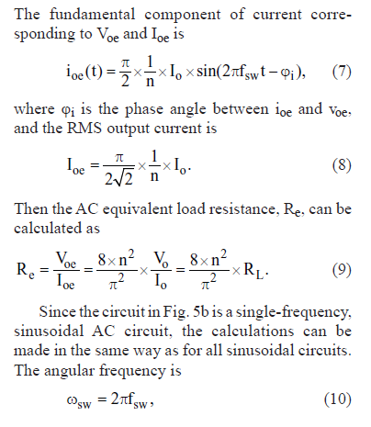
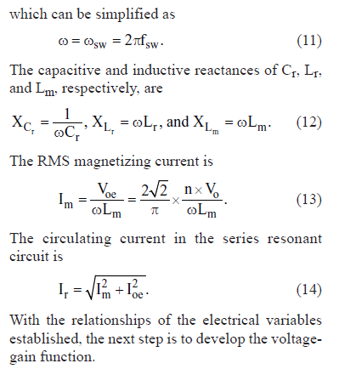
Relationship of Electrical Variables

Slide 11
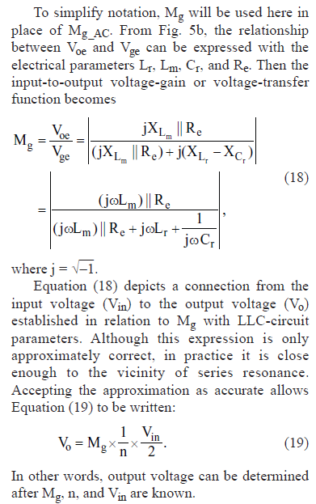
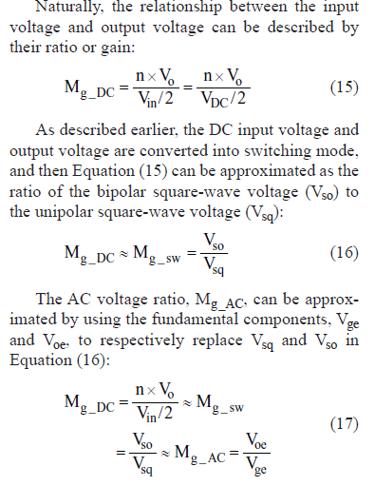
Voltage-Gain Function

Slide 12
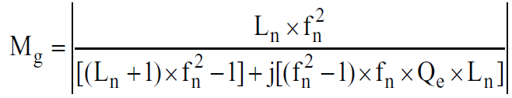
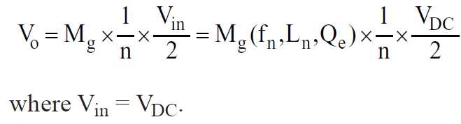

Normalized format of Voltage-Gain function
Normalized frequency $f_{n}= \frac{f_{sw}}{f_{0}}$
Inductance ration $L_{n}= \frac{L_{m}}{L_{r}}$
Quality factor $Q_{e}= \frac{\sqrt{{L_{r}}/{C_{r}}}}{R_{e}}$
Voltage gain can be written as
The relation b/w input and output voltage can be expressed as

Slide 13
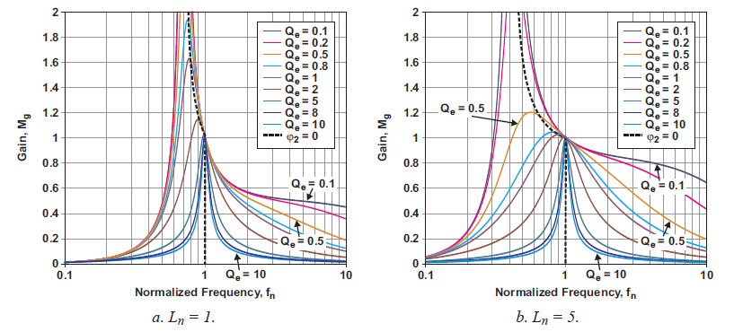
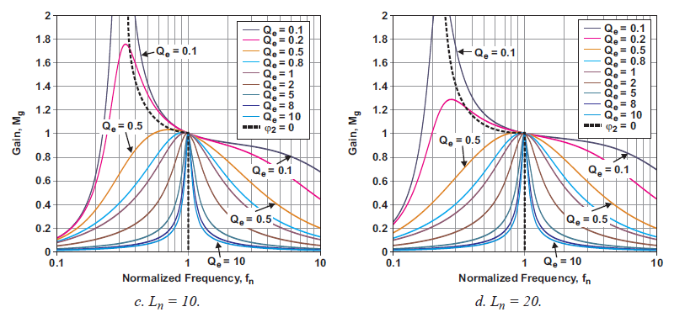
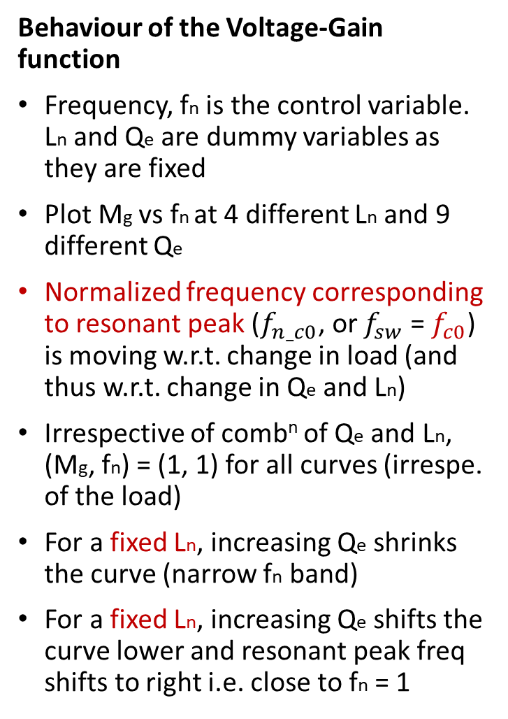
Behaviour of the Voltage-Gain function
Frequency, fn is the control variable. Ln and Qe are dummy variables as they are fixed
Plot Mg vs fn at 4 different Ln and 9 different Qe
Normalized frequency corresponding to resonant peak ($f_{n_c0}$, or $f_{sw}$ = $f_{c0}$) is moving w.r.t. change in load (and thus w.r.t. change in Qe and Ln)
Irrespective of comb^{n} of Qe and Ln,
(Mg, fn) = (1, 1) for all curves (irrespe. of the load)
For a fixed Ln, increasing Qe shrinks the curve (narrow fn band)
For a fixed Ln, increasing Qe shifts the curve lower and resonant peak freq shifts to right i.e. close to fn = 1

Slide 14
Let’s take an simple illustration,
As RL : Infinite → 0
Qe : 0 → Infinite
Mg-peak : Infinite → 1
fc0 : fp → f0
For a fixed Qe, decrease in Ln shrinks curve, the whole curve is squeezed (horizontally) and fc0 moves towards f0. Also, peak gain increases and better freq. control band.

Slide 15
Design Considerations

Slide 16
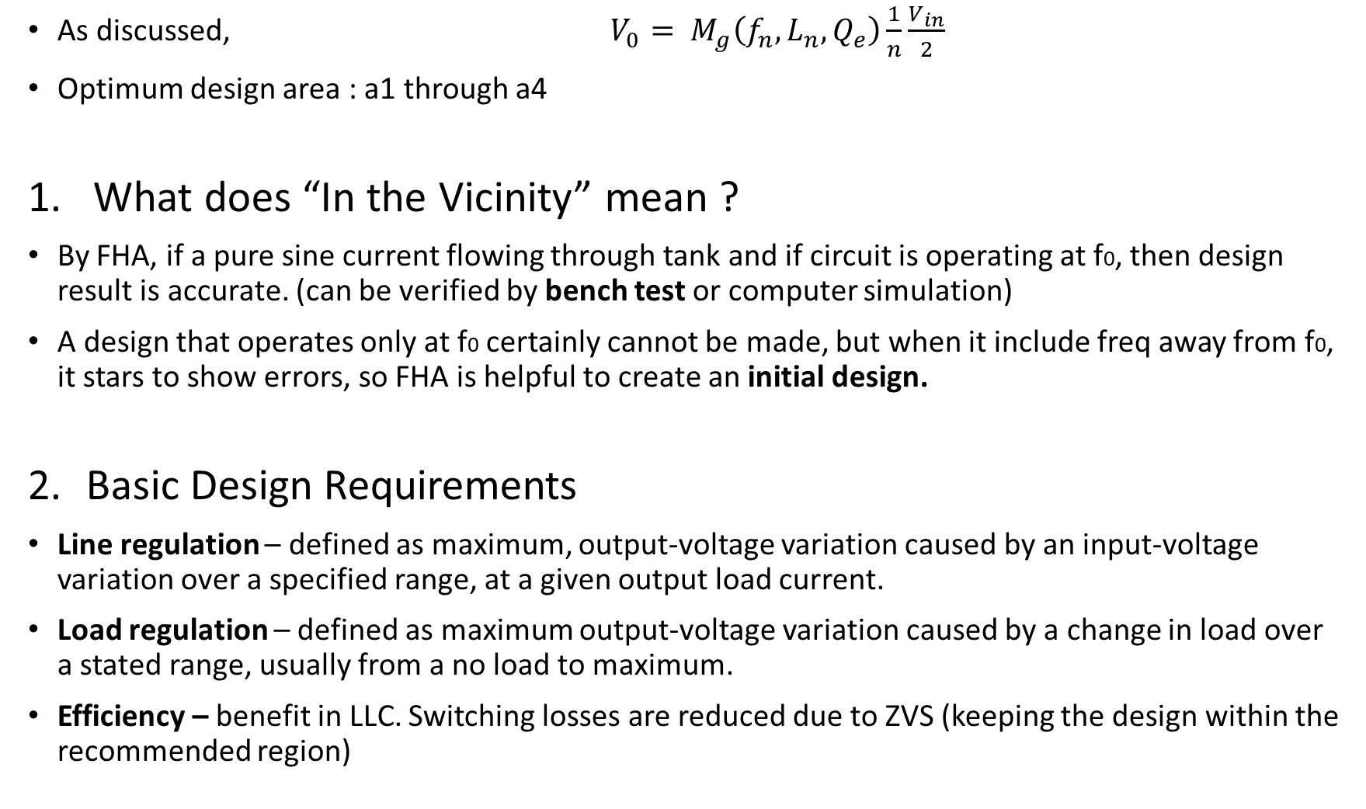
As discussed, $V_{0}= M_{g}\left(f_{n}, L_{n},Q_{e}\right)\frac{1}{n}\frac{V_{in}}{2}$
Optimum design area : a1 through a4
What does “In the Vicinity” mean ?
By FHA, if a pure sine current flowing through tank and if circuit is operating at f0, then design result is accurate. (can be verified by bench test or computer simulation)
A design that operates only at f0 certainly cannot be made, but when it include freq away from f0, it stars to show errors, so FHA is helpful to create an initial design.
Basic Design Requirements
Line regulation – defined as maximum, output-voltage variation caused by an input-voltage variation over a specified range, at a given output load current.
Load regulation – defined as maximum output-voltage variation caused by a change in load over a stated range, usually from a no load to maximum.
Efficiency – benefit in LLC. Switching losses are reduced due to ZVS (keeping the design within the recommended region)

Slide 17
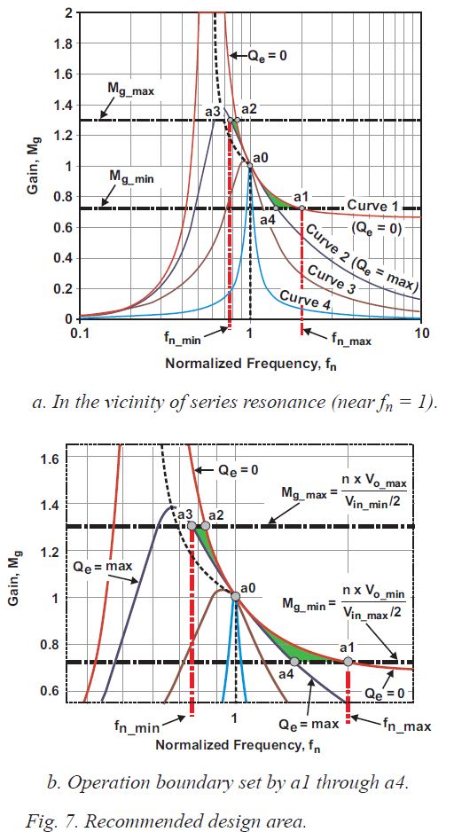
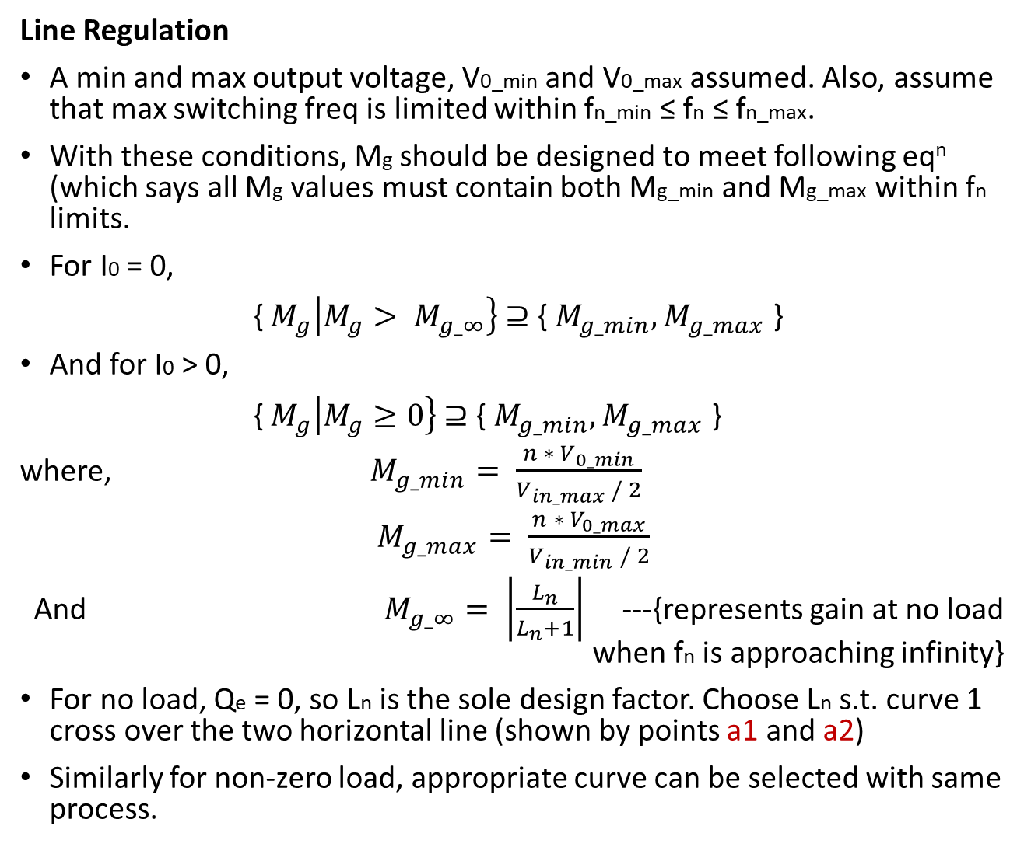
Line Regulation
A min and max output voltage, V0_min and V0_max assumed. Also, assume that max switching freq is limited within fn_min ≤ fn ≤ fn_max.
With these conditions, Mg should be designed to meet following eq^{n} (which says all Mg values must contain both Mg_min and Mg_max within fn limits.
For I0 = 0,
{${ M}_{g}\left|M_{g}> M_{g_∞}\right\} \text{⊇}\text{ \{ }M_{g_min},M_{g_max}\text{ \}}$
And for I0 > 0,
{${ M}_{g}\left|M_{g}≥0\right\} \text{⊇ \{ }M_{g_min},M_{g_max}\text{ \}}$
where, $M_{g_min}= \frac{n ∗ V_{0_min}}{V_{in_max} / 2}$
$M_{g_max}= \frac{n ∗ V_{0_max}}{V_{in_min} / 2}$
And $M_{g_∞}= \left|\frac{L_{n}}{L_{n}+1}\right|$ ---{represents gain at no load when fn is approaching infinity}
For no load, Qe = 0, so Ln is the sole design factor. Choose Ln s.t. curve 1 cross over the two horizontal line (shown by points a1 and a2)
Similarly for non-zero load, appropriate curve can be selected with same process.

Slide 18
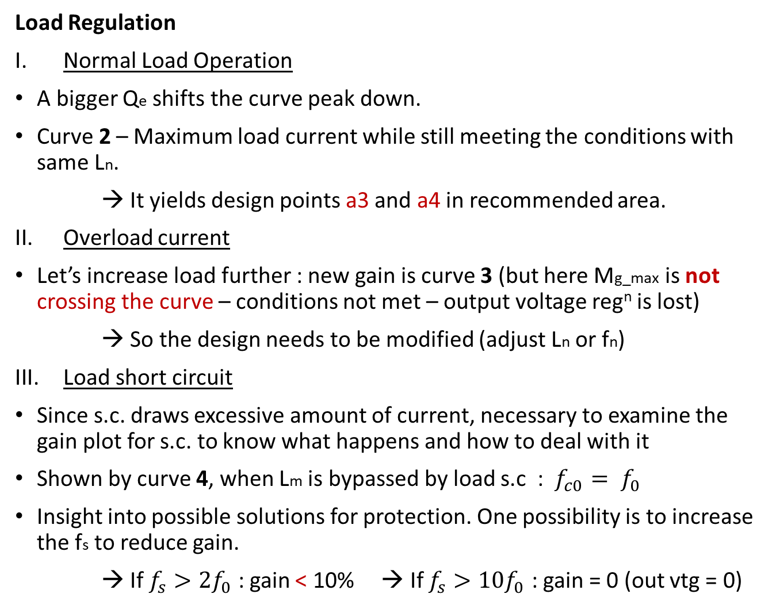
Load Regulation
Normal Load Operation
A bigger Qe shifts the curve peak down.
Curve 2 – Maximum load current while still meeting the conditions with same Ln.
→ It yields design points a3 and a4 in recommended area.
Overload current
Let’s increase load further : new gain is curve 3 (but here Mg_max is not crossing the curve – conditions not met – output voltage reg^{n} is lost)
→ So the design needs to be modified (adjust Ln or fn)
Load short circuit
Since s.c. draws excessive amount of current, necessary to examine the gain plot for s.c. to know what happens and how to deal with it
Shown by curve 4, when Lm is bypassed by load s.c : $f_{c0}= f_{0}$
Insight into possible solutions for protection. One possibility is to increase the fs to reduce gain.
→ If $f_{s}>2f_{0}$ : gain < 10% → If $f_{s}>10f_{0}$ : gain = 0 (out vtg = 0)

Slide 19
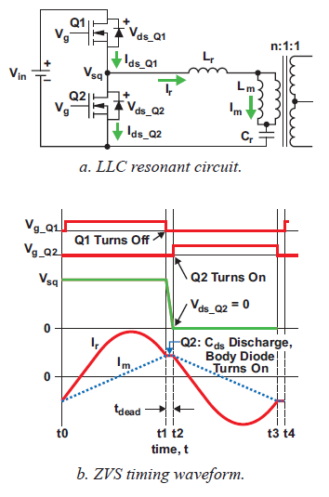
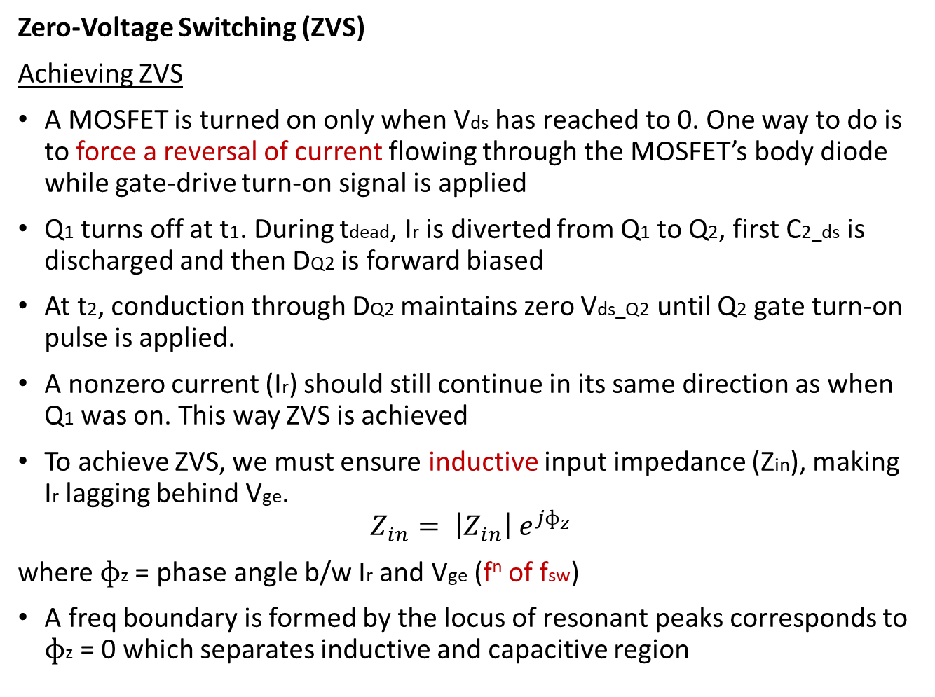
Zero-Voltage Switching (ZVS)
Achieving ZVS
A MOSFET is turned on only when Vds has reached to 0. One way to do is to force a reversal of current flowing through the MOSFET’s body diode while gate-drive turn-on signal is applied
Q1 turns off at t1. During tdead, Ir is diverted from Q1 to Q2, first C2_ds is discharged and then DQ2 is forward biased
At t2, conduction through DQ2 maintains zero Vds_Q2 until Q2 gate turn-on pulse is applied.
A nonzero current (Ir) should still continue in its same direction as when Q1 was on. This way ZVS is achieved
To achieve ZVS, we must ensure inductive input impedance (Zin), making
Ir lagging behind Vge.
$$Z_{in}= \left|Z_{in}\right| e^{{jɸ}_{z}}$$
where $ɸ$z = phase angle b/w Ir and Vge (f^{n} of fsw)
A freq boundary is formed by the locus of resonant peaks corresponds to $ɸ$z = 0 which separates inductive and capacitive region
Notes:
When $ɸ$z > 0, the impd. Is Inductive, < 0, capacitive, = 0, resistive

Slide 20
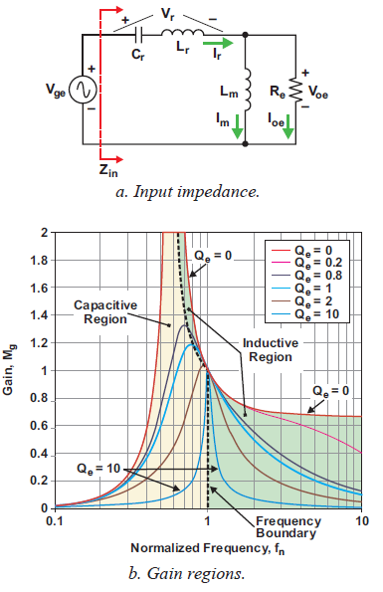
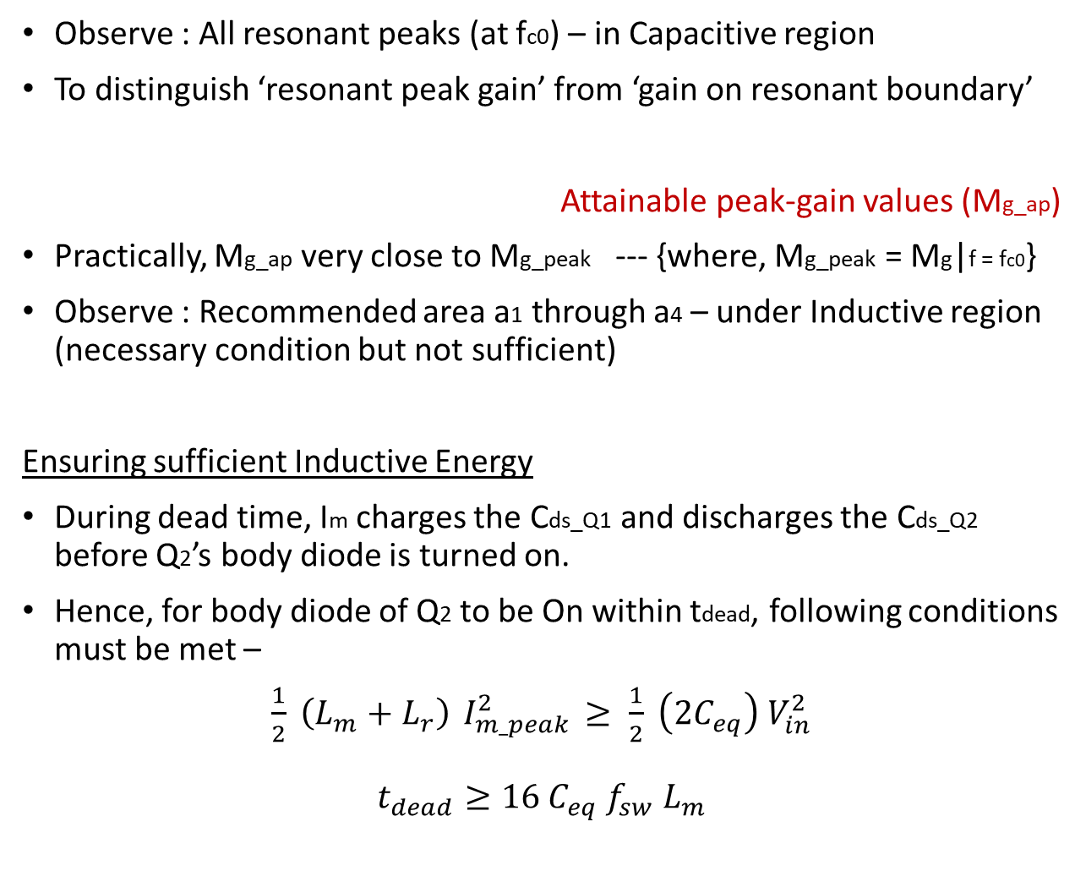
Observe : All resonant peaks (at fc0) – in Capacitive region
To distinguish ‘resonant peak gain’ from ‘gain on resonant boundary’
Attainable peak-gain values (Mg_ap)
Practically, Mg_ap very close to Mg_peak --- {where, Mg_peak = Mg|f = fc0}
Observe : Recommended area a1 through a4 – under Inductive region
(necessary condition but not sufficient)
Ensuring sufficient Inductive Energy
During dead time, Im charges the Cds_Q1 and discharges the Cds_Q2 before Q2’s body diode is turned on.
Hence, for body diode of Q2 to be On within tdead, following conditions must be met –
$\frac{1}{2} \left(L_{m}+L_{r}\right){ I}_{m_peak}^{2} ≥ \frac{1}{2} \left({2C}_{eq}\right){ V}_{in}^{2}$
$$t_{dead}≥{16 C}_{eq}{ f}_{sw}{ L}_{m}$$

Slide 21

Selecting Design Parameters fsw, n, Ln, and Qe
Selecting the Switching frequency (fsw)
Most applications – fsw below 150 kHz (usually b/w 100 and 150 kHz)
The lower the fsw – the bulkier the converter and the less important sw. losses and efficiency become.
Cond^{n} loss become dominant
Selecting the T/f turns ratio (n)
Initially, set Mg = 1 for output nominal voltage (Vo_nom) --- {where, Vo_nom = $\frac{V_{o_min} + V_{o_max}}{2}$ }
similarly input nominal voltage = Vin_nom
Then n = $M_{g} \frac{{V_{in}}/2}{V_{o}}= \left.\frac{{V_{in_nom}}/2}{V_{o_nom}}\right|$Mg = 1
Selecting Ln and Qe
How are the Proper Ln and Qe selected ?
Not necessary

Slide 22
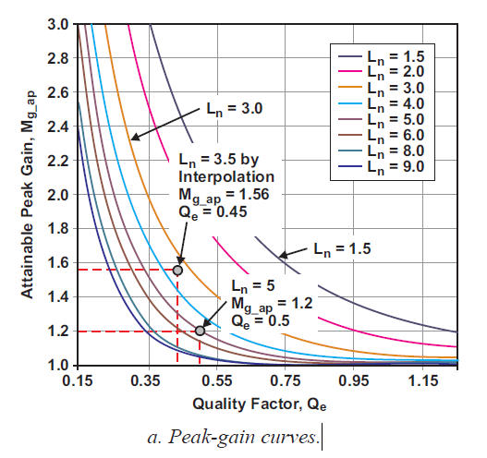
The most critical point is a3. (corresponds to Qe_max) – designed to avoid operation in capacitive region
Point a3 -> Cross point b/w Mg_max line and gain curve
itself depends upon comb^{n} of Ln and Qe
So, one way is to make some wild guess – makes it’s a difficult way
More desirable approach – to create a common tool to represent gain curves that can be reused by different designs.
Since Mg_ap (corresponding to Qe_max) is the highest gain of concern for a design,
gain-curves plots can be created beforehand.
Then, Ln and Qe can be selected to achieve Mg_ap > Mg_max based on tool i.e. Mg_ap curves
How are the Mg_ap curves obtained ?
From fig-6 (slide 13), choose one Qe = 0.5 at a fixed Ln = 5
so we get, Mg_ap = 1.2 at (Ln, Qe) = (5, 0.5)
Now, with this fig, Plot (Mg_ap, Qe) = (1.2, 0.5) at Ln = 5
So, a peak-gain curve can be formed as a function of Qe at a
fixed Ln. Also this process can be repeated for different Ln.
Note: The points should be in recommended area (a1 through a4) by fig-7 (slide-18)
Notes:
Rough Flow → First choose a point Mg-max inside rec. area -> Then choose Mg-ap > Mg-max -> Then select Qe, Ln with selected Mg-ap -> Then from this fig, select Qe -> Then select Ln as suitable

Slide 23
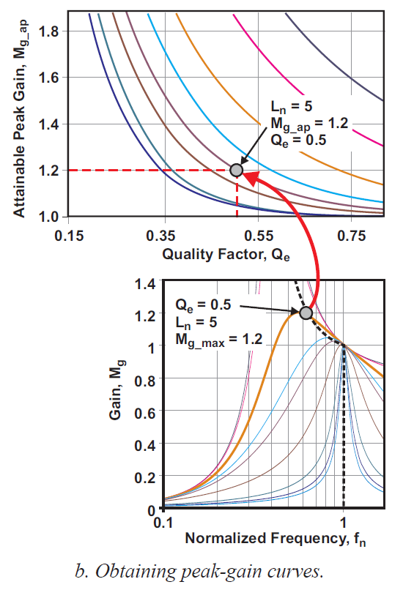
How are Mg_ap curves used in a Design ?
Let Mg_max = 1.2, then choose Mg_ap greater than 1.2.
Choose Qe and Ln corresponding to 1.2 → Choose Ln = 5 (let)
Since we need gain > Mg_max so by previous fig, Qe = 0.5
Similarly if Ln = any other value → accordingly Qe can be
chosen
What Ln and Qe values are Best if they are All greater than Mg_max ?
Smaller Ln → higher peak gain (for fixed Qe)
Smaller Ln → Smaller Lm → Higher Im, can help ZVS but more cond^{n} loss
Smaller Qe → higher peak gain but large freq variation
A good start : Ln = 5 and Qe = 0.5
Usually reiteration is needed after initial selection

Slide 24
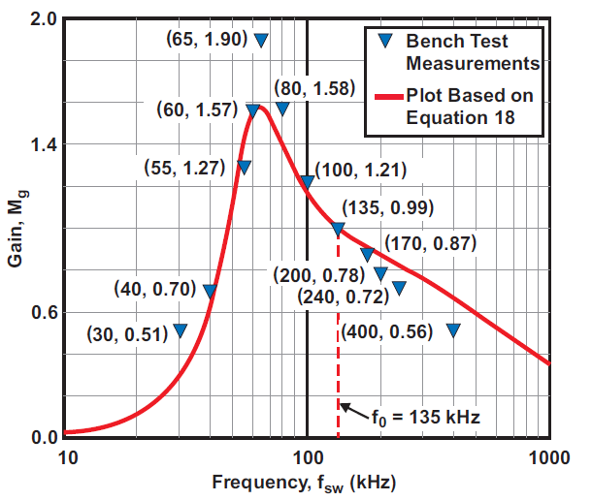
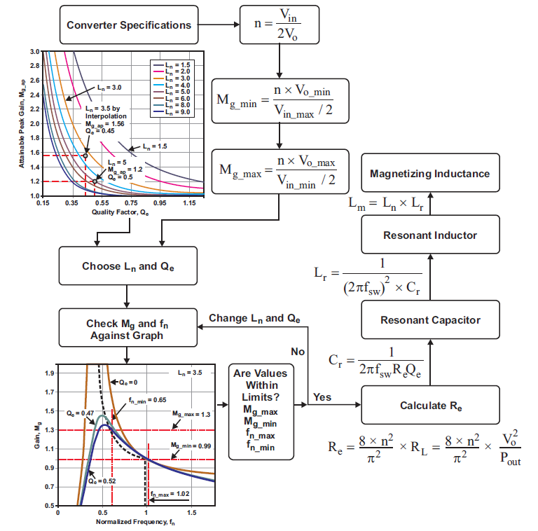
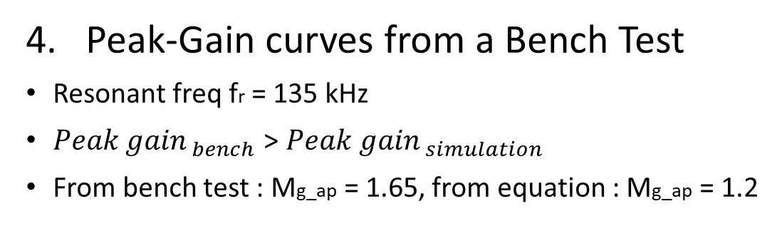
Resonant-network design flow
Peak-Gain curves from a Bench Test
Resonant freq fr = 135 kHz
${Peak gain}_{ bench}$ > ${Peak gain}_{ simulation}$
From bench test : Mg_ap = 1.65, from equation : Mg_ap = 1.2

Slide 25
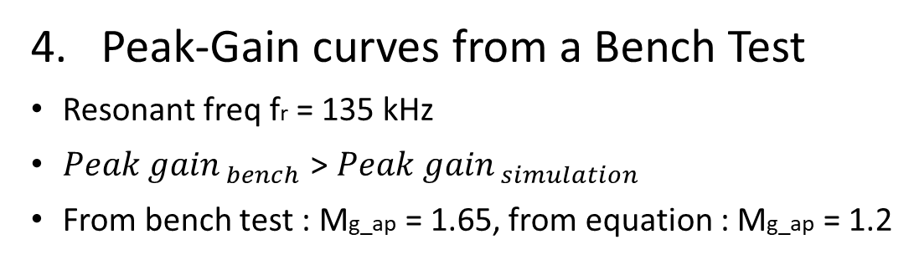
Peak-Gain curves from a Bench Test
Resonant freq fr = 135 kHz
${Peak gain}_{ bench}$ > ${Peak gain}_{ simulation}$
From bench test : Mg_ap = 1.65, from equation : Mg_ap = 1.2
Resonant-network design flow

Slide 26
Design Example

Slide 27
Design Example
Input voltage: 375 to 405 VDC
Rated output power: 300W
Output voltage: 12 VDC
Rated output current: 25 A
Output-voltage line regulation (Io = 1 A) : ≤ 1%
Output-voltage load regulation (Vin = 390 V) : ≤ 1%
Output-voltage peak-to-peak ripple (Vin = 390V and Io = 25A) : ≤ 1%
Efficiency (Vin = 390V and Io = 25A) : ≥ 90%
Switching frequency (normal operation): 70 to 150 kHz

Slide 28
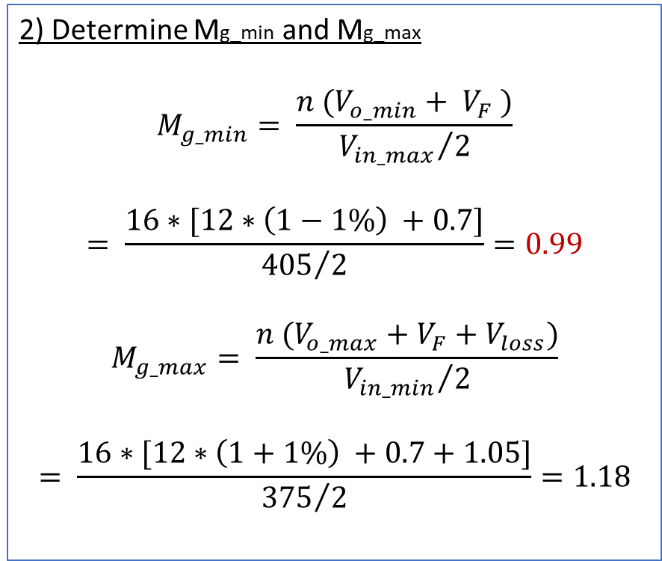
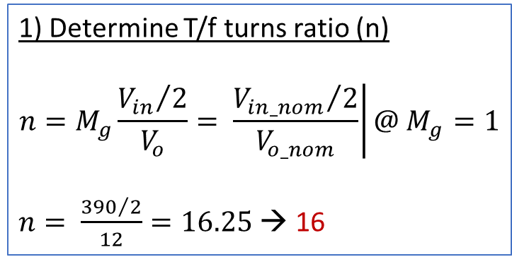
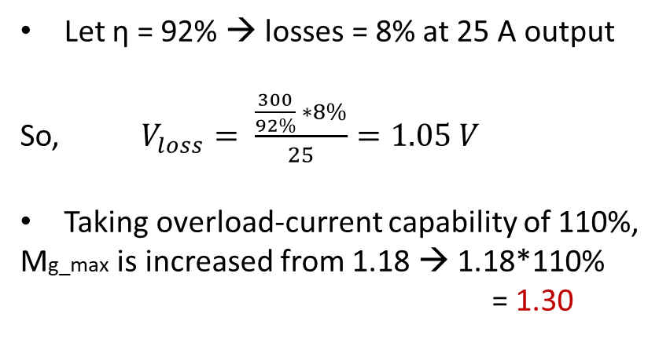
Design Steps
1) Determine T/f turns ratio (n)
$$n=M_{g}\frac{{V_{in}}/2}{V_{o}}= \left.\frac{{V_{in_nom}}/2}{V_{o_nom}}\right|{@ M}_{g}=1$$
$n= \frac{{390}/2}{12}=16.25$ → 16
2) Determine Mg_min and Mg_max
$$M_{g_min}= \frac{n (V_{o_min}+ V_{F} )}{{V_{in_max}}/2}$$
$$= \frac{16∗[12∗\left(1−1\%\right) +0.7]}{{405}/2}=0.99$$
$$M_{g_max}= \frac{n (V_{o_max}+V_{F}+V_{loss})}{{V_{in_min}}/2}$$
$$= \frac{16∗[12∗\left(1+1\%\right) +0.7+1.05]}{{375}/2}=1.18$$
Let η = 92% → losses = 8% at 25 A output
So, $V_{loss}= \frac{\frac{300}{92\%} ∗8\%}{25}=1.05 V$
Taking overload-current capability of 110%,
Mg_max is increased from 1.18 → 1.18*110%
= 1.30

Slide 29
From Notebook

